Slide 1
How to BEST Use This Material...
We’re thrilled to be able to release a portion of our Application Security training material to the community! In doing so, we’re cognizant that the content within is unable to meet all team needs, skill levels, or contexts (e.g. software languages).
To make the most out of this content, we’d offer a few tips:
Take what you like and leave the rest behind -- there’s no one-size-fits-all
Transfer the content valuable to your organization into more familiar branding
Replace the merit of examples shown with ones more akin to your tech stack
Share internal examples of previous security issues to increase the impact
Throw in details about your security program and application security team
Mix-and-match content from other sources to build a training for your needs

Slide 2
Available Lab Resources
It’s highly encouraged that as part of your curriculum, hands-on labs are given across the training to help attendees gain a direct, technical understanding of topics being shared. This will maximize their engagement and increase learning.
Below are a list of potential lab resources that may be beneficial to consider:
Hunter2 Community (Hosts Duo’s own lab module contributions for free)
OWASP Juice Shop extremely popular vulnerable-by-design web service
OWASP WebGoat provides a lesson-based capability along with hacking
Google Gruyere is an older set of challenges but still widely applicable today
flAWS.cloud & flAWS2.cloud focused on AWS-centric security challenges

Slide 3
Additional Training Tips
Create a feedback form that is filled out by your attendees each offering
Be sure to provide many breaks during the day
Small (~15) class sizes
Set “Ground Rules” so students are not getting distracted from the class
Handle IT setup logistics prior to the class date
Take questions regularly

Slide 4
Advanced Application Security
Application Security Team, Duo Security

Slide 5
Cryptography

Slide 6
Cryptography Can Be Difficult
So many options, so little time
NIST standards: AES, DES
CBC, ECB, CTR block types
Authenticated encryption
The “mystery” around cryptography, especially for newer developers
Just “rolling your own” can be tempting (but dangerous)

Slide 7
Crypto Issue #1
Security Expertise
Assumption that developers have necessary security knowledge
Different developers, different experience
Knowing the difference between regulatory-compliance and effective data protection
What to protect & when to protect it
Encrypted at rest
Encrypted during transmission
Standards like FIPS 140-2 can help
Security standard used to approve cryptographic modules

Slide 8
Crypto Issue #2
Poor Key Management
No centralized source for key storage
Insufficient or non-existent key rotation policies
Allowing “weak keys” to be used
Key reuse
Ensuring key is available when requested
Insider threats or accidental key exposure

Slide 9
Crypto Issue #3
Third-Party Protection
Using encryption to protect data living on non-encrypted, third-party systems (think S3)
Relying on third-party to protect data correctly
Be sure to confirm their standards and policies
Hardware security module (HSM) for key storage
For example, Amazon offers HSM as a service - CloudHSM

Slide 10
Cryptography Tips for Developers
Avoid key reuse
Only generate keys using a cryptographically strong random source
Use only known and widely used standard algorithms
When possible, make use of authenticated encryption over non-authenticated
Define robust key storage mechanisms
Plan a key rotation policy

Slide 11
Content Security
Policies

Slide 12
What are Content Security Policies?
Security control designed to prevent injection (like XSS) and external code execution attacks
“Agreement” between the client and the server
Supported in most major browsers
Configured via a standard HTTP header: Content-Security-Policy

Slide 13
What are Content Security Policies?
Allows control over several aspects of the content
Use of inline CSS and Javascript
Control of dynamic Javascript code execution (eval)
Using dynamic CSS statements
Form actions
Iframe sources
Allows definition of the “origin” of content
self
domain(s) including wildcard support

Slide 14
Content Security Policy Examples
Content-Security-Policy: default-src 'self' *.trusted.com
Content-Security-Policy: default-src 'self'; img-src *; script-src https://userscripts.example.com

Slide 15
Content Security Policy Examples
Content-Security-Policy: default-src 'self'; script-src 'self' https://www.google-analytics.com; img-src 'self' https://www.google-analytics.com

Slide 16
Content Security Policy Features
Provides a reporting feature to log violations
report-uri
Sent as a POST request to the defined endpoint
Includes URI of requested resource, policy that caused the violation, portion of script causing the issue, section of the policy violated
Allows for “reporting only” versus enforcement via Content-Security-Policy-Report-Only header
While most major browsers support policies, Internet Explorer (and Edge) support many less directives

Slide 17
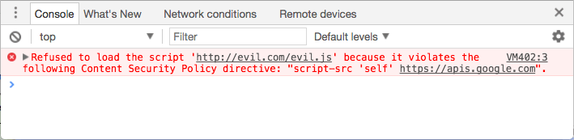
Content Security Policy Tips
Older browsers may require the X-Content-Security-Policy header
Some frameworks include a CSP by default, also easy to inject via middleware
The nonce option allows for even further lockdown

Slide 18
Client-Side
Injection

Slide 19

What is Client-Side Injection?
Injection of malicious code or content via data stored on the client-side only
Data sources include:
Local SQLite databases on mobile devices
Localstorage in browsers
Content from other locations in the page (forms)
Most often caused by missing or broken input validation and poor output escaping

Slide 20
Client-Side Injection Example: Javascript
<script>
function append() {
var input = document.getElementById(‘input’).value;
var output = document.getElementById(‘output’);
output.innerHTML = output.innerHTML + string;
}
</script>
<html>
<body>
<form>
<input type=”text” id=”input” value=””>
<button type=”submit” onclick=”append()”>Submit</button>
</form>
</body>
</html>

Slide 21
Client-Side Injection Example: CSS
<a id="input">Click me</a>
<script>
if (location.hash.slice(1)) {
document.getElementById("input").style.cssText = "color: " +
location.hash.slice(1);
}
</script>
For http://mysite.com/#red:
<style>
#input{
color: red;
}
</style>
https://www.url/#red; @import "https://externalsource/navigation.css”

Slide 22
Client-Side Injection Example: Redirect
<script>
var redir = location.hash.substring(1);
if (redir)
window.location='http://'+decodeURIComponent(redir);
</script>
Valid: http://url/?#www.url/login
Malicious: http://url/?#www.attackerurl/phishing-page

Slide 23
Client-Side Injection Example: Cookies
Set-Cookie: sessionid=38afes7a8; HttpOnly; Path=/
Set-Cookie: id=a3fWa; Expires=Wed, 21 Oct 2015 07:28:00 GMT; Secure; HttpOnly
Set-Cookie: qwerty=219ffwef9w0f; Domain=somecompany.co.uk; Path=/; Expires=Wed, 30 Aug 2019 00:00:00 GMT
Cookies are completely user controlled!

Slide 24

Mitigations
Use well-vetted templating libraries, don’t roll your own
Avoid the use of “workarounds” in templating (ex: outputting raw data)
Avoid the direct use of user controllable input in client-side resources
When querying local databases, ensure the use of prepared statements/parameterized queries

Slide 25
Broken Authentication
Controls

Slide 26


Slide 27
What are authentication controls?
Control types
Single-factor
Multi-factor
Continuous
Common authentication controls
Credential-based (identifier)
Token based (JSON tokens)
Out-of-band methods
Third-party services
Origin of request

Slide 28
Planning
Base authentication controls around risk
Risks involved with information disclosure
Risks of data tampering or loss of integrity
Design and document based on risk assessment
Provides a unified perspective on what’s covered and where
Threat modeling
Completely implement and update control
Improper control usage
Failure to update all locations when making changes could result in logic differences
Enforce strong standards for credential/identifier storage

Slide 29
Common Flaws: Technology
Poor login protection
No rate limiting
Additional controls not implemented after X number of failures
No authentication on sensitive resources!
No quality enforcement
Permission policy not in place/weak
Passwords not evaluated for reuse (i.e. haveibeenpwned)
Poor session state handling
Session not recycled on permission change
Session IDs not validated or transmitted in an insecure way

Slide 30

Common Flaws: Human
Phishing
Vishing (Voice)
Social Engineering
Poor credential handling habits
Good security education is key!

Slide 31
Authentication Control Testing
Test common weaknesses
Unencrypted credential transmission
Default credentials and other “insecure by default” settings
Weak secondary controls (remember me, password reset, etc)
Bypass via “forceful browsing” or parameter manipulation
Testing with more than one type of user
Determine major access control differences (make a matrix)
Static files with predictable filenames and available via direct web request
Automated testing via tooling

Slide 32
Authentication Control Testing
Key:
Text = Should they be able to do it?
Color=Could they do it?
Green=Positive
Red=Negative
Role | Update Passwords | Update Email | Change Account Data | Upgrade Account to Admin | View Logs
Admin | Yes | Yes | Yes | Yes | Yes
User | Yes | Yes | No | No | No
Unauthenticated | No | No | No | No | No

Slide 33
Broken Authorization
Controls

Slide 34
Broken Authorization Controls
AuthN proves identity, AuthZ proves what they can do
Multiple levels of controls can be more effective
Split by user level (ex: normal user vs admin)
Split by permission set
Split by access control list of users Issues with consistent data access across application
Multiple controls can add to overall complexity
Potential for bypass via partially implemented controls

Slide 35
What are Authorization Controls?
Control types
Discretionary - Based on user identity and “has” or “in” relationship, owns own data
Mandatory - Based on protection requirements of resource (must match)
Common authorization controls
Access list
Permissions (has, has not)
Permissions grouping (roles)
Other: restrictions on location, time of day, system accessing from

Slide 36
Common Flaws: Technology
Direct Object Reference
Changing values in the URL
Changing values in POST/PUT/DELETE request body content
ID, GUID, hash
Missing function-level access control
“Forceful browsing” to locate misconfigurations
Static files with predictable filenames and resources available via direct web request
Logic Flaws
Beginning a workflow in the wrong place
Bypass of controls by forceful browsing to other resources rather than the one directed to

Slide 37

Common Flaws: Technology

Slide 38
XML External Entity Injection (XXE)

Slide 39
What is XML External Entity Injection?
Entities are objects in XML documents
Defined in the base XML specification
Acts as a reusable value
Replaced as a part of parsing the XML document
Injection caused by malicious entity definition
User-provided content injected directly into the document
XML parser misconfigured to expand entities
Multiple potential vulnerabilities
Accessing local files
Loading external resources

Slide 40
How does XXE happen?
1.
User input is allowed into the XML content.
2.
This content is passed into a parser for evaluation and extraction.
3.
Due to misconfiguration, the parser expands the entities by default.
4.
The malicious user XML content is then activated as a part of processing.
5.
The malicious XML then executes the attack, potentially causing:
Denial of service
Information leakage
Code execution

Slide 41
XXE Example #1: Billion Laughs
<?xml version="1.0"?>
<!DOCTYPE lolz [
<!ENTITY lol "lol">
<!ELEMENT lolz (#PCDATA)>
<!ENTITY lol1 "&lol;&lol;&lol;&lol;&lol;&lol;&lol;&lol;&lol;&lol;">
<!ENTITY lol2 "&lol1;&lol1;&lol1;&lol1;&lol1;&lol1;&lol1;&lol1;&lol1;&lol1;">
<!ENTITY lol3 "&lol2;&lol2;&lol2;&lol2;&lol2;&lol2;&lol2;&lol2;&lol2;&lol2;">
<!ENTITY lol4 "&lol3;&lol3;&lol3;&lol3;&lol3;&lol3;&lol3;&lol3;&lol3;&lol3;">
........
]>
<lolz>&lol100;</lolz>

Slide 42
XXE Example #2: File Injection
<?xml version="1.0" encoding="ISO-8859-1"?>
<!DOCTYPE foo [ <!ELEMENT foo ANY >
<!ENTITY xxe SYSTEM "file:///etc/passwd" >]>
<creds>
<user>&xxe;</user>
<pass>mypass</pass>
</creds>
<?xml version="1.0" encoding="ISO-8859-1"?>
<!DOCTYPE foo [ <!ELEMENT foo ANY >
<!ENTITY xxe SYSTEM "http://192.168.0.1/secret.txt" >]>
<creds>
<user>&xxe;</user>
<pass>mypass</pass>
</creds>

Slide 43
XXE Example #3: Code Execution
<?xml version="1.0" encoding="ISO-8859-1"?>
<!DOCTYPE foo [ <!ELEMENT foo ANY >
<!ENTITY xxe SYSTEM "expect://id" >]>
<creds>
<user>&xxe;</user>
<pass>mypass</pass>
</creds>
“expect” is a PHP extension allows interaction with processes through PTY.

Slide 44
Mitigation
Disable auto-entity expansion on the parser
Wide range of different parsers for many different languages, each with its own method
Ensure the setting is the default
Access
If access to the entities is required, use parser controls
Prevent access to external entities
Take extra care when using these values
Don’t allow unvalidated user input into your XML
Ensure that user input is valid and only contains what you expect
If there is a requirement, escape it correctly for the XML context

Slide 45
Lack of Sufficient Logging & Monitoring

Slide 46


Slide 47
Lack of Sufficient Logging & Monitoring
You can’t detect what you can’t measure
Provides context into the use and abuse of your environment
Logging based on failures is important, but sometimes successes are too
Real-time detection is crucial to response times and approach
Logging must be analyzed
Useless without analysis
Multiple benefits of good logging practices
Easier to locate information in case of an investigation
Potentially simpler identification of the origin of an attack
Log evaluation post-incident can provide additional context to correct similar issues

Slide 48
Security Logging Issues
Difficult to detect anomalies
Tooling can help (machine learning, thresholds, pattern matching)
No replacement for humans
Log Overload
Too many logs to be overly useful without heavy evaluation
Monitoring alerts
May require “threat hunters”
False positives can eclipse actual problems

Slide 49
Security Logging Recommendations
Plan on what to log and how to log it
Log on purpose, “everything” is usually too much
Define high risk areas that may require more detailed logs
Define the important indicators
Not all log information is useful
Ensure the logging and monitoring solution is sustainable
Will the new feature or system you’re adding greatly increase the log content?
Does it measure up to the continuing requirements of your organization?
Can it easily be integrated with centralized logging?

Slide 50
Security Logging Recommendations
Logging locations
Access level changes (login, assume user role, logout)
Higher-risk data changes
Details about secondary controls (forgot password, 2FA)
Files added or accessed
Authentication failures
Authorization failures
User input validation failures
Session management issues
Changes in permissioning
Third-party errors
Exceptions

Slide 51
Using Vulnerable Components

Slide 52
What are Vulnerable Dependencies?
Any piece of software (component) that has known vulnerabilities, published or unpublished
Vulnerability sources
Public disclosure via independent researcher
Disclosure by the project itself
Results of automated scanning (e.g. Black Duck, SourceClear)
Internally known issues

Slide 53
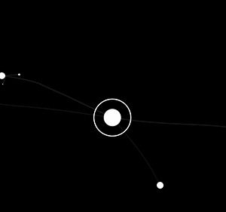
Why is this so important?
90% of all applications make use of third-party components
Dependencies of dependencies of dependencies...

Slide 54
A Flavor for Every Language
...and many, many more.
Python packages
Ruby gems
NPM packages (Node.js)
Microsoft .NET packages
WordPress plugins
Composer packages (PHP)
Maven (Java)

Slide 55
What are the risks?
Risk depends on the functionality the component provides
Templating libraries: XSS injection
Database library: SQL injection
Encryption library: Weak or incorrect cipher use
Authentication library: Bypass of controls
Integration of one or more components could also increase the risk

Slide 56
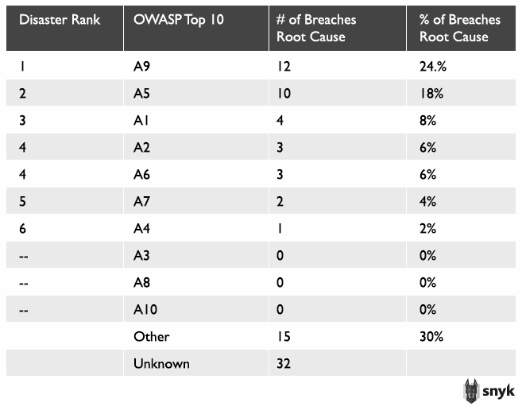
What are the risks?

Slide 57
Breach Examples by Vulnerable Components
VerticalScope/Techsupportforum.com breach
45 million passwords and IP addresses were stolen from a network of over 1,100 websites and forums
Caused by vulnerability in an old version of vBulletin (SQL injection)
Ubuntu forums breach
2 million usernames, IP addresses and passwords were compromised
Caused by a vulnerability in the Forumrunner component (SQL injection)

Slide 58
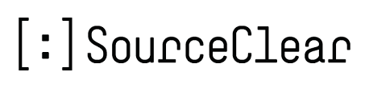
Path to Upgrade
Issue is reported either by the project or third party
Problem is fixed and new release is made
Ideally a public disclosure is made, either officially or as a part of release notes
Development teams are then required to determine where the component is used & apply new version

Slide 59
Mitigations
Rely on the project to fix the issues
Lack of control over when the fix happens
Quality of the fix might be questionable depending on project developers
Fork and fix the issues yourself
Time to fix greatly increases
Requires extensive in-house knowledge of the component
Puts a maintenance burden on the team to keep up with future releases (and patch those if needed)

Slide 60
HTTP Header Injection

Slide 61
What is HTTP Header Injection?
User-defined content is included in the HTTP headers of the request/response
Source could be from application data
Also could be from related information (such as referrer URI)
Injection of a newline (CRLF) then adding a custom header
Also called “HTTP Request Splitting” where headers are “split” with additional newline
Potential vulnerabilities depend on how header information is used in application
Any value that can be controlled via headers
Most languages support “last in wins” parsing of multiple headers

Slide 62
HTTP Header Injection Example
URL: http://mysite.com/user?username=testuser1
GET /user?username=testuser1 HTTP/1.1
Host: mysite.com
X-Username: testuser1
username=testuser1&id=1

Slide 63
HTTP Header Injection Example
URL: http://mysite.com/user?username=%0d%0a%0d%0aLocation:http://google.com
GET /user?username=%0d%0a%0d%0aLocation:http://google.com HTTP/1.1
Host: mysite.com
X-Username:
Location: http://google.com
username=testuser1&id=1

Slide 64
Impactful Headers
Some headers are more useful than others
Set-Cookie
Access-Control-Allow-Origin
Location
X-XSS-Protection
Strict-Transport-Security
X-Frame-Options
X-Content-Type-Options
Content-Security-Policy

Slide 65
Mitigations
Prevent the use of user-definable values in your headers as much as possible
Sometimes unavoidable (as in the case of Referer)
If user input is required, ensure that all newlines are correctly escaped
\n encodes to %0A
\r encodes to %0D
Use language level functions to prevent injection
PHP includes checks on inputs to the header() function for newlines
Flask (Python web framework) includes newline checks in functions setting headers

Slide 66
JSON Injection

Slide 67
What is JSON Injection?
Injection of user-defined values into a JSON document or data
On its own, could potentially be used to overwrite existing data or corrupt the JSON structure
Side effects
Corrupted JSON could trigger an exception, leading to information exposure
Poor JSON parsing could lead to malicious values being used in other locations (such as XSS in an item’s value)
Potential of additional false information being appended to the document, possibly allowing for an auth bypass if used in logic.

Slide 68
What does JSON Injection look like?
{
"username":"user1",
"password":"$2y$10$VBOVO3XJHT7.jwykGyWMk.4Pvg7qgEba.YLcU3xBV7Vp9IqzRswcO",
"name":"Chris",
"email":"me@example.com"
}

Slide 69
What does JSON Injection look like?
{
"username":"user1",
"password":"$2y$10$VBOVO3XJHT7.jwykGyWMk.4Pvg7qgEba.YLcU3xBV7Vp9IqzRswcO",
"name":"Chris", "password":"known-string",
"email":"me@example.com"
}
Duplicate key names could do funny things but might just throw a warning from the parser.

Slide 70
What could cause this?
Malicious user input making its way into the data (unverified)
Poor parsing and creation practices
Poor output escaping or direct use of values without sanitization

Slide 71
Mitigations
Use as little user input in JSON as possible, validating the input to ensure correctness
Use only well-established and vetted parsing libraries and tools.
Avoid the direct use of values pulled from JSON, escaping according to the correct context

Slide 72
Replay Attacks

Slide 73
What are Replay Attacks?
Repeating the same content in an effort to reproduce the effect
Could be performed by valid user or attacker
Sometimes captured as a part of a Man-in-the-Middle attack
Could be sent to the same location or a different location that accepts the same data
Not just restricted to web-based requests

Slide 74
Why do they work?
No uniqueness in the session or request
No detection of changes in the session (like IP address)
Plain-text messages not protected in transit
Does not require knowledge of the payload context but impact is difficult to determine without it

Slide 75
How to prevent the attack
Include uniqueness into the request
Header with dynamic value verified on the server
Time-bound session identifiers rotated frequently
One-time protection (such as a password)
Reducing risk by limiting window a request could be valid
Preventing interception with encryption in transit
HTTPOnly on (session) cookies can prevent access

Slide 76
Secure JSON Web Tokens

Slide 77
JSON Web Tokens (JWT)
Based on a standard: RFC 7519
Provides more context than a basic session identifier
Relies on:
JWS - JSON Web Signature
JWE - JSON Web Encryption
Signed to ensure integrity of the token’s contents
Often sent as a Bearer header for reauthorization on following requests

Slide 78
Building JWT
Three sections:
Header defines type of token and algorithm to use for the signature
Claims are the details (default and custom)
Signature (None, HMAC, RSA)
All sections are defined as JSON structures
Each section is (URL safe) base64 encoded and combined with “.”
base64urlEncoding(header)+'.'+base64urlEncoding(payload)+'.'+base64urlEncoding(signature)

Slide 79
JWT Claims
Default claims
iss: Issuer
sub: Subject
aud: Audience
exp: Expiration
nbf: “Not before”
iat: Issued At
iti: JWT ID
Custom claims
No sensitive data! Remember, these can be decoded

Slide 80
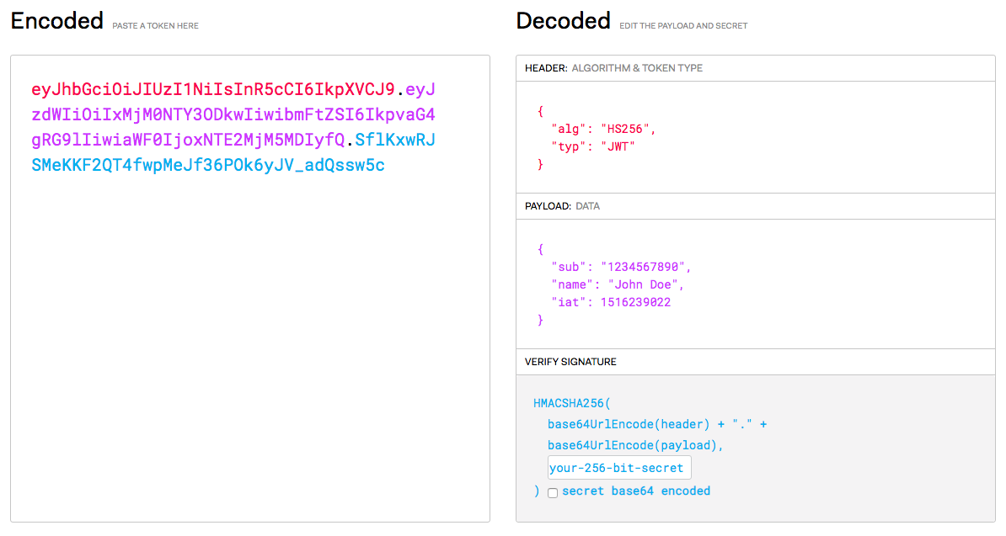
JWT Example

Slide 81
Common JWT Issues
Sensitive information in the claims
Individual tokens cannot be easily revoked (until timeout defined by claim)
By user or by service
“Stale” values if the token is not regenerated when data is updated
Intended to be stateless, using them as stateful is basically a glorified session token
Using the None algorithm
Not verifying key length before signature generation

Slide 82
Want to Learn More?[REPLACE]
[REPLACE]
[REPLACE]
[REPLACE]
[REPLACE]
[REPLACE]
[REPLACE]
[REPLACE]
[REPLACE]
[REPLACE]
[REPLACE]
[REPLACE]
[REPLACE]
[REPLACE]
Defense in Depth: https://gist.github.com/maxvt/bb49a6c7243163b8120625fc8ae3f3cd
Developer’s Guide to Encryption: https://crypto.stanford.edu/cs142/papers/web-session-management.pdf
Broken Access Control: https://www.owasp.org/index.php/Top_10-2017_A5-Broken_Access_Control
Mobile Top 10 - Client Side Injection: https://www.owasp.org/index.php/Mobile_Top_10_2012-M4_Client_Side_Injection
HTTP Header Injection: https://dzone.com/articles/crlf-injection-and-http-response-splitting-vulnera
JSON injection: https://blog.qualys.com/technology/2016/08/03/testing-ajax-applications-with-json-input-for-vulnerabilities-using-qualys-was
Client-side reflected JSON injection: https://portswigger.net/kb/issues/00200371_client-side-json-injection-reflected-dom-based
OWASP Logging Cheatsheet: https://github.com/OWASP/CheatSheetSeries/blob/master/cheatsheets/Logging_Cheat_Sheet.md
Security Logging Best Practices: https://reciprocitylabs.com/audit-log-best-practices-for-information-security/
OWASP XXE Prevention Cheatsheet: https://cheatsheetseries.owasp.org/cheatsheets/XML_External_Entity_Prevention_Cheat_Sheet.html

